Slide 1

Database Management Systems
Shamim Ahmad

Slide 2
ERD to Tables

Slide 3
Reduction of an E-R Schema to Tables
Primary keys allow entity sets and relationship sets to be expressed uniformly as tables which represent the contents of the database.
A database which conforms to an E-R diagram can be represented by a collection of tables.
For each entity set and relationship set there is a unique table which is assigned the name of the corresponding entity set or relationship set.
Each table has a number of columns (generally corresponding to attributes), which have unique names.
Converting an E-R diagram to a table format is the basis for deriving a relational database design from an E-R diagram.

Slide 4
Representing Entity Sets as Tables

Slide 5
Representing strong Entity Sets as Tables
A strong entity set reduces to a table with the same attributes.
SID
Name
SSN
Name
Student
Advisor
Professor
Major
Dept
GPA
SID
Name
Major
GPA
SSN
Name
Dept
1234
John
CS
2.8
9999
Smith
Math
5678
Mary
EE
3.6
8888
Lee
CS

Slide 6
Representing Relationship Sets as Tables

Slide 7
Many-to-many Relationship Sets
For many-to-many relationship
Same thing as one-to-one relationship without total participation.
Primary key of this new schema is the union of the foreign keys of both entity sets.

Slide 8
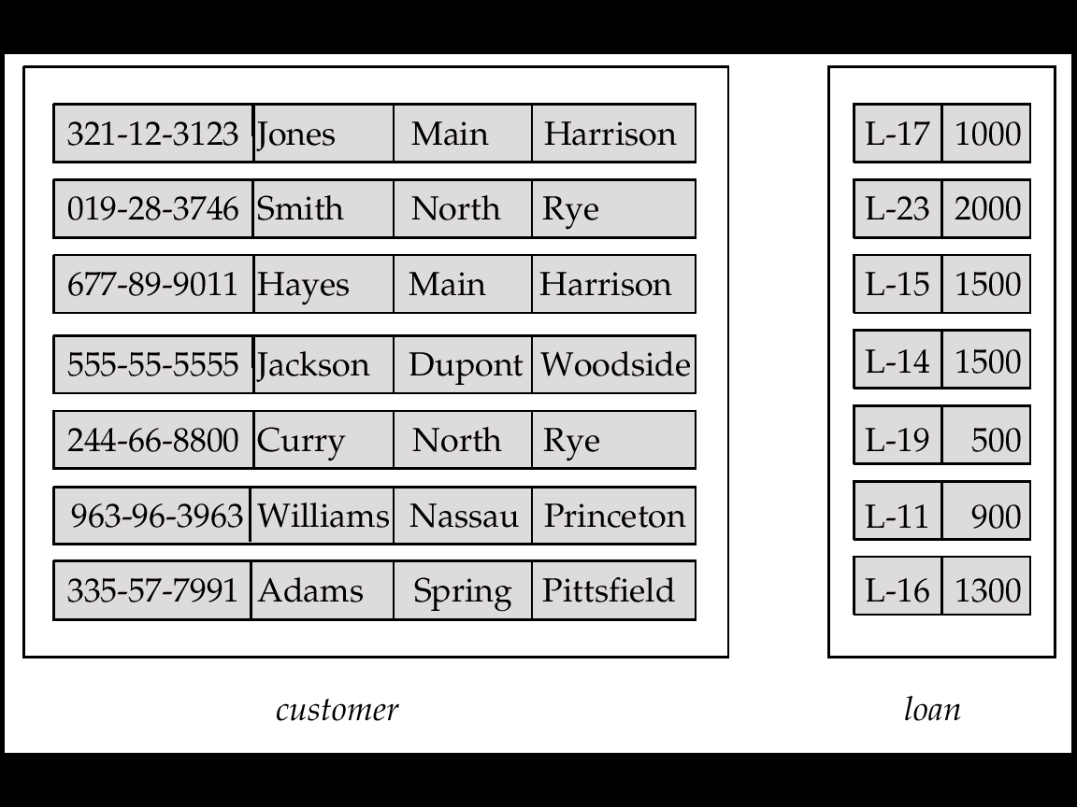
Entity Sets customer and loan
customer-id customer- customer- customer- loan- amount name street city number

Slide 9
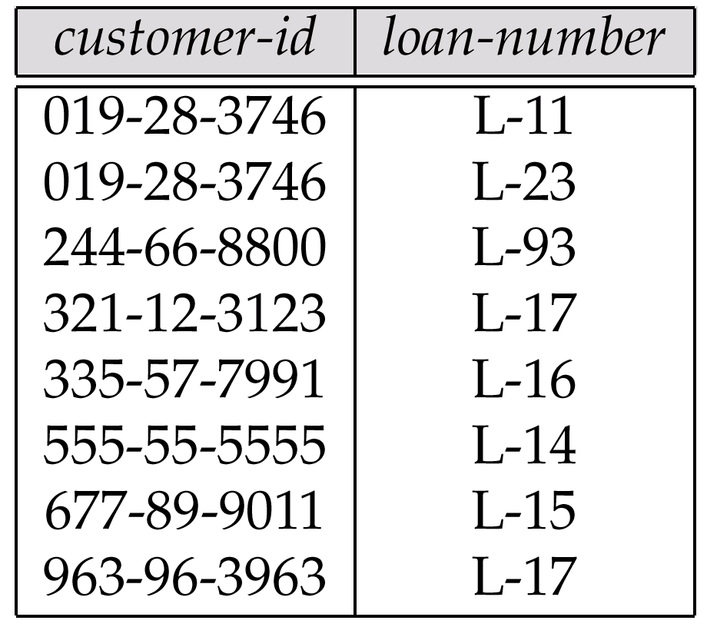
Representing Relationship Sets as Tables
A many-to-many relationship set is represented as a table with columns for the primary keys of the two participating entity sets, and any descriptive attributes of the relationship set.
E.g.: table for relationship set borrower

Slide 10
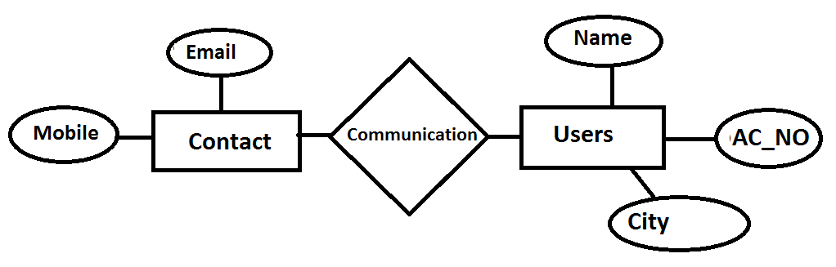
Many To Many Relationship(Cont.)
PK
PK
Email | Mobile
ononnaontora@gmail.com | 01700000000
sumaia@vu.edu.bd | 01700000000
sumaiavu381332@gmail.com | 01700000000
raisha12@gmail.com | 01700000011
raisha_afroza@gmail.com | 01700000011
FK
FK
Name | AC_NO. | City
Ononna | AC11 | Raj.
Raisha | AC12 | Khul.
Mahbub | AC25 | Dhaka
Email | Name
ononnaontora@gmail.com | ononna
sumaia@vu.edu.bd | ononna
sumaiavu381332@gmail.com | ononna
raisha12@gmail.com | Raisha
raisha_afroza@gmail.com | Raisha
mahbub@gmail.com | Mahbub

Slide 11
Foreign Key:
A FOREIGN KEY is a key used to link two tables together.
A FOREIGN KEY is a field (or collection of fields) in one table that refers to the PRIMARY KEY in another table.
The table containing the foreign key is called the child table, and the table containing the candidate key is called the referenced or parent table.
S_id | S_Name | S_CGPA
13231003 | Tasnim | 3.59
13231001 | Jui | 3.66
13231111 | Dipty | 3.78
S_id | Session | Dept
13231003 | Summer13 | CSE
13231001 | Summer13 | CSE
13231117 | Fall14 | EEE
TableName: Student_Info
TableName: Dept_Info

Slide 12
Representing Relationship sets without a separate Tables

Slide 13
Many-to-one and One-to-many
For one-to-many relationship w/out total participation
Same thing as one-to-one

Slide 14
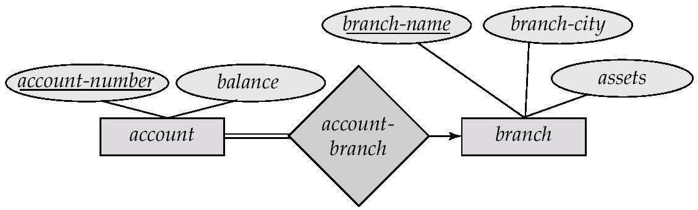
Redundancy of Tables
Many-to-one and one-to-many relationship sets that are total on the many-side can be represented by adding an extra attribute to the many side, containing the primary key of the one side
E.g.: Instead of creating a table for relationship account-branch, add an attribute branch name to the entity set account

Slide 15
Example – Many-to-One Relationship Set
Semester
SID
Name
N:1 Relationship
SSN
Student
Advisor
Professor
Major
GPA
Dept
Name
SID
Name
Major
GPA
Pro_SSN
Ad_Sem
9999
Bart
Economy
-4.0
123-456
Fall 2006
8888
Lisa
Physics
4.0
567-890
Fall 2005
* Primary key of this table is SID

Slide 16
One-to-one Relationship Set
For one-to-one relationship w/out total participation
Build a table with two columns, one column for each participating entity set’s primary key. Add successive columns, one for each descriptive attributes of the relationship set (if any).
For one-to-one relationship with one entity set having total participation
Augment one extra column on the right side of the table of the entity set with total participation, put in there the primary key of the entity set without complete participation as per to the relationship

Slide 17
One-to-One (W/out Total)
Degree
SID
Name
ID Code
Student
study
Major
Major
GPA
SID
Maj_ID Co
S_Degree
9999
07
1234
8888
05
5678

Slide 18
One-to-One (Total Student side)
Condition
SID
Name
1:1 Relationship
S/N #
Student
Have
Laptop
Major
GPA
Brand
SID
Name
Major
GPA
LP_S/N
Hav_Cond
9999
Bart
Economy
-4.0
123-456
Own
8888
Lisa
Physics
4.0
567-890
Loan
* Primary key can be either SID or LP_S/N

Slide 19
Composite and Multivalued Attributes
Composite attributes are flattened out by creating a separate attribute for each component attribute
E.g. given entity set customer with composite attribute name with component attributes first-name and last-name the table corresponding to the entity set has two attributes name.first-name and name.last-name

Slide 20
Composite and Multivalued Attributes
A multivalued attribute M of an entity E is represented by a separate table EM
Table EM has attributes corresponding to the primary key of E and an attribute corresponding to multivalued attribute M
Each value of the multivalued attribute maps to a separate row of the table EM

Slide 21
Representing Composite Attribute
SSN
Name
SSN
Name
Street
City
Professor
9999
Dr. Smith
50 1st St.
Fake City
8888
Dr. Lee
1 B St.
San Jose
Address
Street
City

Slide 22
Representing Multivalue Attribute
SID
Name
The primary key for this table is Student_SID + Children, the union of all attributes
Children
Student
Major
GPA
Stud_SID
Children
1234
Johnson
1234
Mary
SID
Name
Major
GPA
5678
Bart
1234
John
CS
2.8
5678
Lisa
5678
Homer
EE
3.6
5678
Maggie

Slide 23
Representing Relationship Set N-ary Relationship
Intuitively Simple
Build a new table with as many columns as there are attributes for the union of the primary keys of all participating entity sets.
Augment additional columns for descriptive attributes of the relationship set (if necessary)
The primary key of this table is the union of all primary keys of entity sets that are on “many” side
That is it, we are done.

